Slide 1

Deep Learning Techniques in Load Forecasting
Presented By:- Tolulope Olugbenga

Slide 2
Outline
Introduction / Overview
Investigation
The Benchmark Algorithms
Deep Learning Algorithms
Metrics for Evaluation
Preliminary Analysis – Toronto, Ottawa, Saint John Dataset
Contributions

Slide 3
Introduction / Overview
Load forecasting has been used for over a century to plan and operate electric grids.
Load aggregators, power marketers, independent system operators, regulatory commissions, industrial/commercial firms, banks, trading firms, and insurance companies benefit from load forecasting as well.
Weather, time of day, week, and other variables can all have an impact on load forecasts (i.e., coronavirus outbreak).
Forecasting electricity demand can be made in several ways: very short-term (VSTLF) (1 day), short-term (STLF) (2 weeks), medium-term (MTLF) (3 years), and long-term load forecasting (LTLF > 3 years).
To forecast load, both statistical and machine learning (ML) techniques have been used. ML algorithms are more intelligent and can adapt to non-linear and complex relationships between load and other influencing factors (such as temperature and time of day).

Slide 4
Introduction / Overview
Recently, researchers in this field are interested in deep learning approaches such as recurrent neural networks (RNN), long-short-term memory networks (LSTM), and 1-D convolution neural networks (CNN) because they can learn about temporal dependencies in data inputs.
Tao Hong discussed the myth of the best technique. He said it is determined by the dataset and the forecasting requirements. No single method is likely to be effective in all load forecasting scenarios. Forecast errors differ greatly across utilities, zones, and time horizons.

Slide 5
Investigation
The accuracy of deep learning forecasters is compared to the accuracy of current and conventional ones being used by utilities.
The focus will be on the STLF horizons.
Three different data sets will be examined. Two sets cover ten years of hourly city-wide load aggregation measurements from Ottawa and Toronto from 2010 to 2019.The third dataset from St. John Energy is part of a larger Smart Grid Technologies project at UNB.
Four benchmark forecasters will be compared: seasonal naive, Multiple Linear Regression (MLR), Auto Regressive Integrated Moving Average (ARIMA), and shallow Artificial Neural Network (ANN).
First, we'll construct the benchmark algorithms. Then a CNN or another deep learning algorithm (LSTM) is used.
Finally, the performance of deep learning forecasters will be compared to the performance of benchmark algorithms using our datasets.
We'll look at both overall and peak detection accuracy.

Slide 6
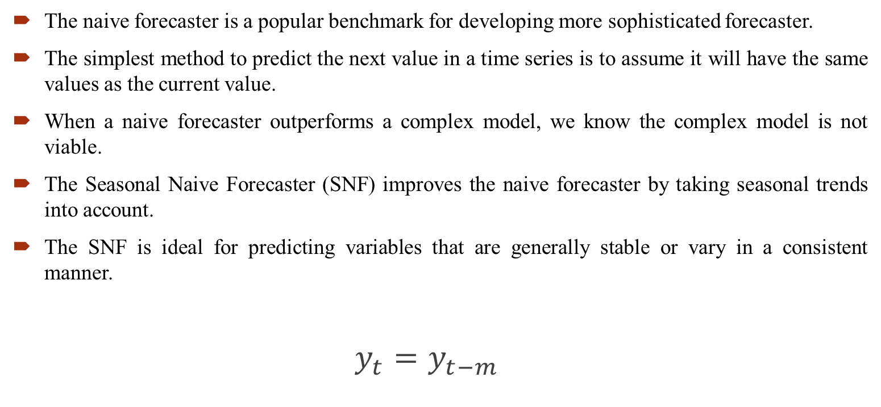
The Benchmark Algorithms – Seasonal Naïve
The naive forecaster is a popular benchmark for developing more sophisticated forecaster.
The simplest method to predict the next value in a time series is to assume it will have the same values as the current value.
When a naive forecaster outperforms a complex model, we know the complex model is not viable.
The Seasonal Naive Forecaster (SNF) improves the naive forecaster by taking seasonal trends into account.
The SNF is ideal for predicting variables that are generally stable or vary in a consistent manner.
$y_{t}=y_{t−m}$

Slide 7
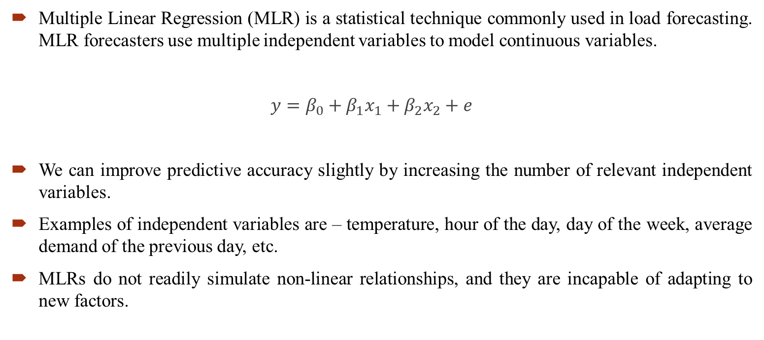
The Benchmark Algorithms - MLR
Multiple Linear Regression (MLR) is a statistical technique commonly used in load forecasting. MLR forecasters use multiple independent variables to model continuous variables.
$y=β_{0}+β_{1}x_{1}+β_{2}x_{2}+e$
We can improve predictive accuracy slightly by increasing the number of relevant independent variables.
Examples of independent variables are – temperature, hour of the day, day of the week, average demand of the previous day, etc.
MLRs do not readily simulate non-linear relationships, and they are incapable of adapting to new factors.

Slide 8
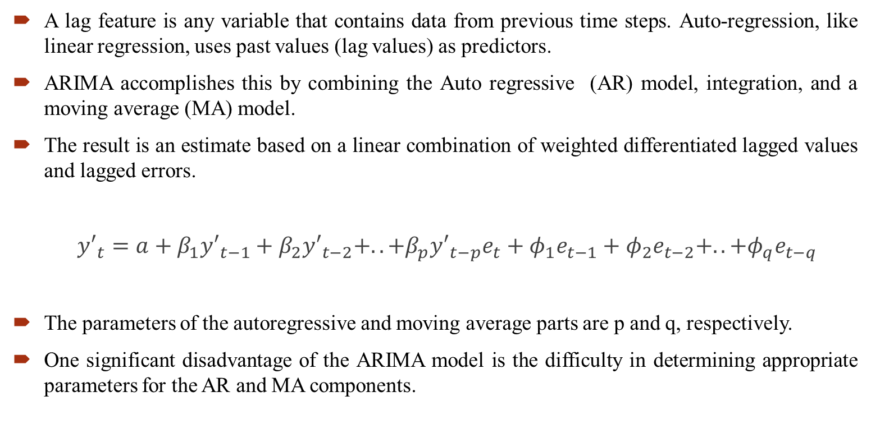
The Benchmark Algorithms - ARIMA
A lag feature is any variable that contains data from previous time steps. Auto-regression, like linear regression, uses past values (lag values) as predictors.
ARIMA accomplishes this by combining the Auto regressive (AR) model, integration, and a moving average (MA) model.
The result is an estimate based on a linear combination of weighted differentiated lagged values and lagged errors.
${y′}_{t}=a+β_{1}{y′}_{t−1}+β_{2}{y′}_{t−2}+..+β_{p}{y′}_{t−p}e_{t}+φ_{1}e_{t−1}+φ_{2}e_{t−2}+..+φ_{q}e_{t−q}$
The parameters of the autoregressive and moving average parts are p and q, respectively.
One significant disadvantage of the ARIMA model is the difficulty in determining appropriate parameters for the AR and MA components.

Slide 9
The Benchmark Algorithms – ANNSTLF
The ANNSTLF is a popular ML load forecaster.
We will employ the third-generation design, which employs two shallow multi-layer feed-forward ANNs with a recursive least squares (RLS) combiner.
The base-load forecaster (BLF) forecasts regular next-day load, whereas the change-load forecaster (CLF) forecasts daily changes in load demand.
The CLF forecaster allows the model to quickly adapt to temperature changes.
The ANNSTLF-G3 has improved prediction accuracy and generated economic benefits for a number of utilities.
According to some publications ANNSTLF-G3 is the best short-term forecaster

Slide 10
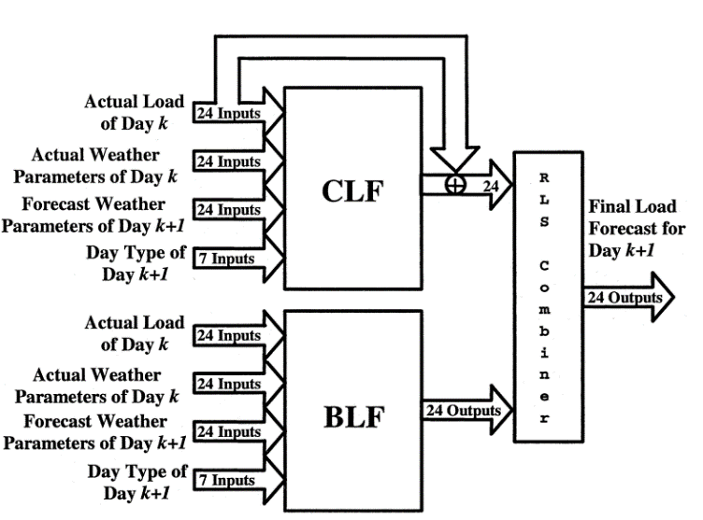
The Benchmark Algorithms – ANNSTLF

Slide 11
Deep Learning Algorithms
The Recurrent Neural Networks (RNN) added memory to neural networks, allowing them to model sequential data. RNNs, however, are susceptible to vanishing or exploding gradients.
This flaw resulted in the development of the LSTM algorithm.
Convolutional neural networks (CNNs) have also gained popularity in load forecasting.
Amaradinghe et al. compared the CNN to LSTM, SVM, ANN, and other algorithms for individual building load forecasting. They concluded that CNN is a viable method for predicting load.
To build the CNN, we used a Base Load Forecaster, a Change in Load Forecaster, and an RLS combiner to replicate the ANNSTLF structure.

Slide 12
Metrics for Evaluation
This study will compare the performance of all forecasters across all datasets, examining both overall performance and performance on a daily, weekly, and monthly timeframe.
The performance will be evaluated according to accuracy in forecast values and accuracy in peak load localization.
Commonly used performance metrics for load forecasting include Mean Absolute Percent Error (MAPE), Mean Bias Error (MBE), Mean Absolute Error (MAE), Root Mean Squared Error (RMSE), and Standard Deviation (SD).
MAE is the simplest way to measure forecast error, but because it is an absolute measure, it does not provide a way to compare measurements across forecast scenarios of different scales.
MAPE is commonly used since the interpretation of comparisons is straightforward. However, MAPE is also limited in that it cannot handle 0-valued actuals, it over-emphasizes high errors during low demands, and it over-emphasizes overshoot errors compared to undershoot errors for forecasting scenarios bounded by 0 (since undershoot errors cannot be worse than 100%, but overshoot errors are unbounded)

Slide 13
Metrics for Evaluation
Both MAE and MAPE tend to be insensitive to rare but significant errors, which are better captured with RMSE, but RMSE is not scaled to the original error, so it is more difficult to interpret.
To fully capture bias and precision, Mean Biased Error (MBE) and standard deviation (SD) can also be used.
All of these are simple tools for determining forecast accuracy, but they are not without limitations.
Our primary focus in this study will be on the MAPE and RMSE, as these are the most frequently used metrics for load forecasting.
The MAPE's limitations do not apply to our datasets because there are no values very close to zero, and the RMSE enables us to detect large forecast errors

Slide 14
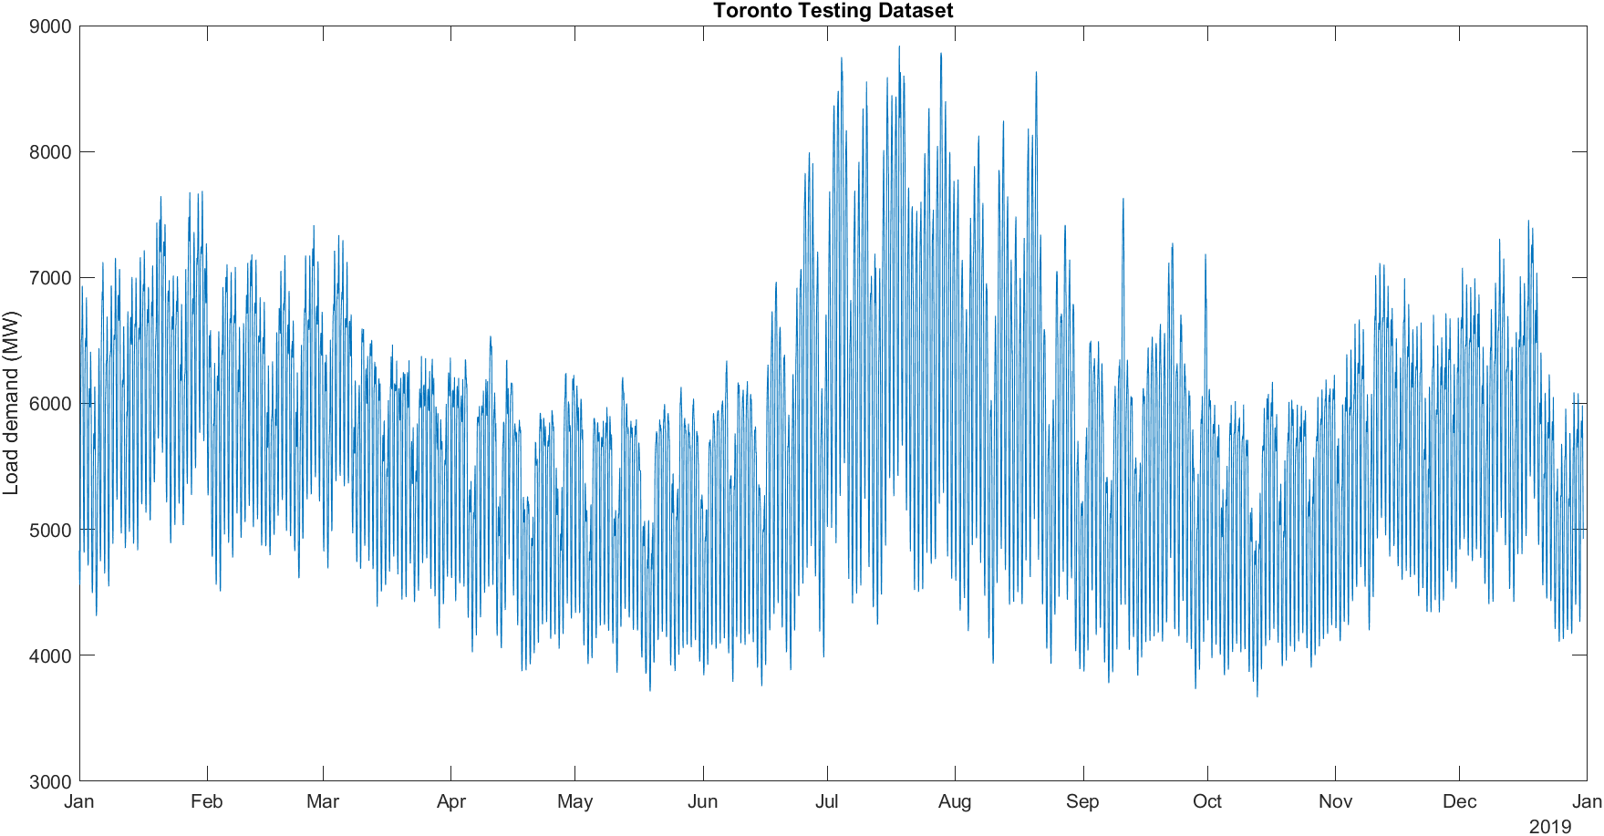
Preliminary Analysis – Toronto Dataset
Metrics | CNN RLS | CNN CLF | CNN BLF | ANN RLS | ANN CLF | ANN BLF | MLR | ARIMA | S-Naïve
'MAPE - Mean Absolute Percent Error' | 2.16 | 2.19 | 2.27 | 2.29 | 2.39 | 2.43 | 3.75 | 4.86 | 6.09
'ME - Mean Error' | -5.41 | -1.23 | -28.90 | -6.71 | 7.99 | -11.31 | -10.81 | 53.98 | -1.67
'MAE - Mean Absolute Error' | 125.73 | 127.10 | 131.84 | 134.64 | 139.40 | 141.26 | 214.88 | 285.43 | 350.36
'MSE - Mean Squared Error' | 36007.64 | 35024.16 | 38191.29 | 40509.58 | 41100.04 | 41441.24 | 86398.61 | 174813.61 | 238215.39
'RMSE - Root Mean Squared Error' | 189.76 | 187.15 | 195.43 | 201.27 | 202.73 | 203.57 | 293.94 | 418.11 | 488.07
'Standard Deviation' | 189.69 | 187.15 | 193.29 | 201.17 | 202.59 | 203.27 | 293.75 | 414.63 | 488.10

Slide 15
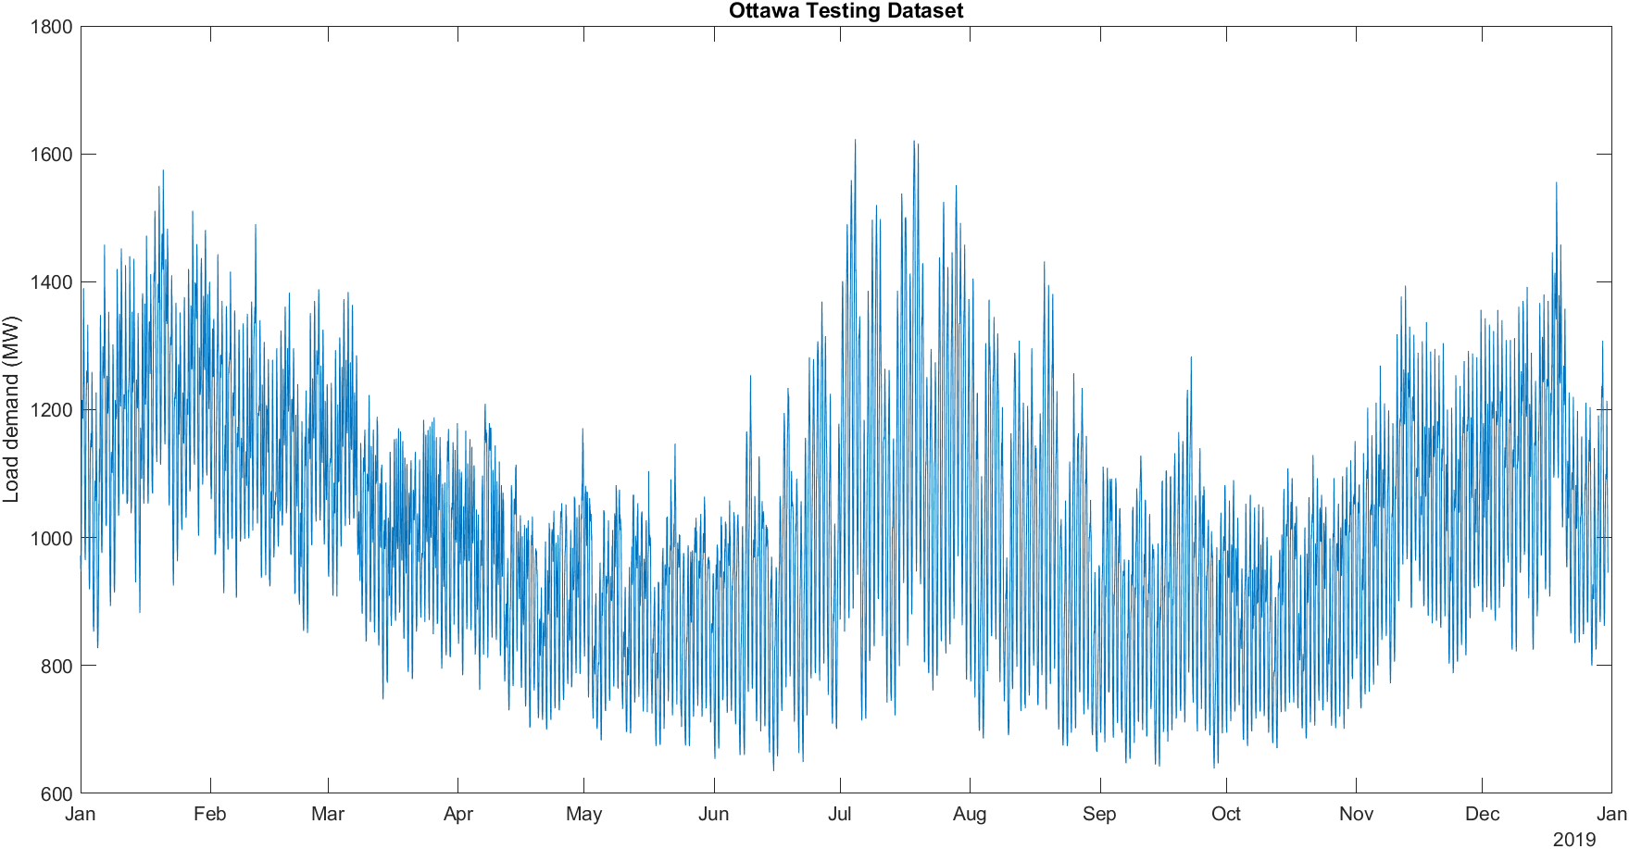
Preliminary Analysis – Ottawa Dataset
Metrics | CNN RLS | CNN CLF | CNN BLF | ANN RLS | ANN BLF | ANN CLF | MLR | ARIMA | S-Naïve
'MAPE - Mean Absolute Percent Error' | 2.72 | 2.85 | 2.96 | 3.11 | 3.47 | 3.56 | 4.78 | 5.06 | 7.33
'ME - Mean Error' | 0.69 | 0.83 | 9.75 | 0.77 | 1.32 | 4.20 | 4.29 | 4.76 | -1.05
'MAE - Mean Absolute Error' | 27.70 | 28.93 | 30.48 | 31.64 | 34.98 | 35.95 | 49.05 | 52.11 | 75.79
'MSE - Mean Squared Error' | 1378.67 | 1440.90 | 1615.39 | 1759.53 | 2033.13 | 2151.74 | 4325.66 | 4991.02 | 10573.67
'RMSE - Root Mean Squared Error' | 37.13 | 37.96 | 40.19 | 41.95 | 45.09 | 46.39 | 65.77 | 70.65 | 102.83
'Standard Deviation' | 37.13 | 37.95 | 38.99 | 41.94 | 45.07 | 46.20 | 65.63 | 70.49 | 102.83

Slide 16
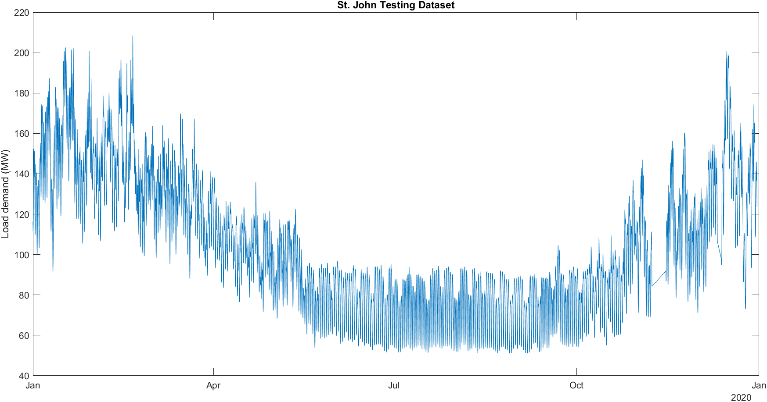
Preliminary Analysis – St. John Dataset
Metrics | ANN RLS | CNN RLS | ANN CLF | CNN CLF | CNN BLF | MLR | ANN BLF | ARIMA | S-Naïve
'MAPE - Mean Absolute Percent Error' | 3.793 | 3.939 | 4.379 | 4.594 | 4.736 | 5.046 | 5.312 | 6.073 | 10.245
'ME - Mean Error' | -0.015 | 0.057 | -0.701 | -0.404 | -0.746 | -0.936 | -1.395 | 0.311 | -0.295
'MAE - Mean Absolute Error' | 3.843 | 3.800 | 4.371 | 4.270 | 4.437 | 5.277 | 5.004 | 6.497 | 11.383
'MSE - Mean Squared Error' | 29.646 | 28.797 | 34.910 | 33.940 | 37.784 | 54.126 | 46.664 | 89.042 | 293.585
'RMSE - Root Mean Squared Error' | 5.445 | 5.366 | 5.908 | 5.826 | 6.147 | 7.357 | 6.831 | 9.436 | 17.134
'Standard Deviation' | 5.445 | 5.366 | 5.867 | 5.812 | 6.102 | 7.298 | 6.688 | 9.432 | 17.133

Slide 17
Contributions
This research will assess the value added by deep learning algorithms (like CNN and LTSM) by comparing their performance to traditional forecasters regarding accuracy in the forecasts and their ability to identify future electrical peak demands.
We aim to explore deep learning approaches to see if they are more adaptive to changes in extraneous factors like annual increases in power demand or temperature shifts.
The goal is to develop forecasters that can adapt to complex data relationships without explicit user intervention. This is an important goal for our Smart-Grid Project industry collaborators, and we will provide an analysis tuned explicitly to their data set.
This contributes to the maturation of the ongoing debate over deep learning methods that have not been thoroughly tested in load forecasting.
Furthermore, because we have also included analysis on data that is publicly available, this work will be reproducible, making it a valuable comparison point for future research within and beyond our smart-grid team.

Slide 18
Thank you for your attention ☺

